Slide 1
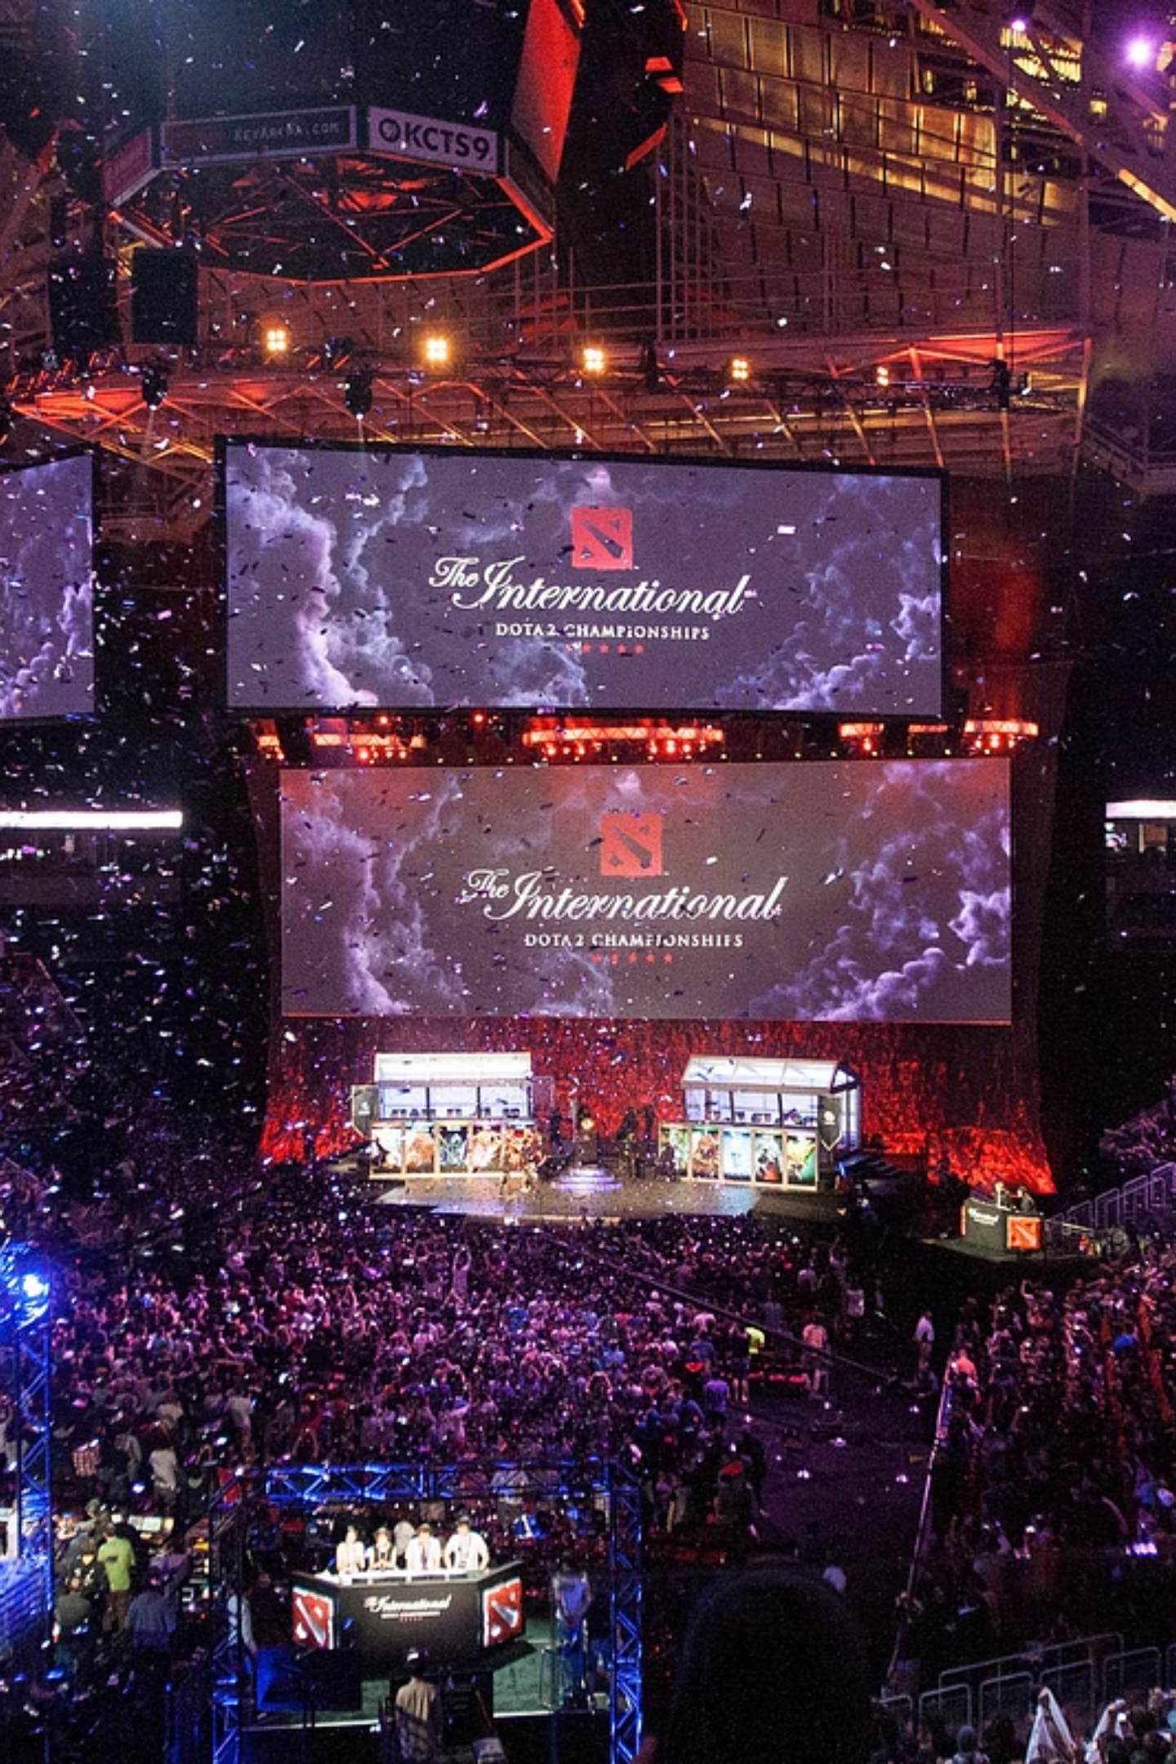
DOTA 2 Match Prediction Using Big Data Analytics
Predicting Professional Esports Outcomes with Apache Spark
Team 12: Anh Pham, Jinzhe Bai, Utkarsh Roy
Course: MET CS777 - Big Data Analytics
1

Slide 2



Introduction - Project Overview
Draft-Only Prediction
Early Game Enhanced
Hero Recommendation
Using hero picks/bans before the game starts
Adding first 10 minutes of gameplay data
Suggesting optimal hero picks based on synergy and counters
Why This Matters?
Professional Esports: $2.4B+ global industry in 2024 with 640M viewers by 2025
Real-time Applications: Live betting odds, tournament broadcasting
Strategic Value: Data-driven coaching and draft strategies
Player Development: Objective performance benchmarking
2

Slide 3
Dataset Overview
Dota 2 Professional Matches (2020-2024) from Kaggle/OpenDota API
27.86GB
123K
12
2020-24
Total Size
Professional Games
Interconnected Files
Time Period
Key Data Files
File
Records
Size
Description
main_metadata.csv
123,692
33 MB
Match outcomes, duration
picks_bans.csv
2,820,604
146 MB
Hero draft selections
radiant_gold_adv.csv
4,081,276
158 MB
Gold advantages over time
objectives.csv
7,481,000
254 MB
Towers, kills, objectives
teamfights.csv
985,000
3 GB
Teamfight statistics
3

Slide 4
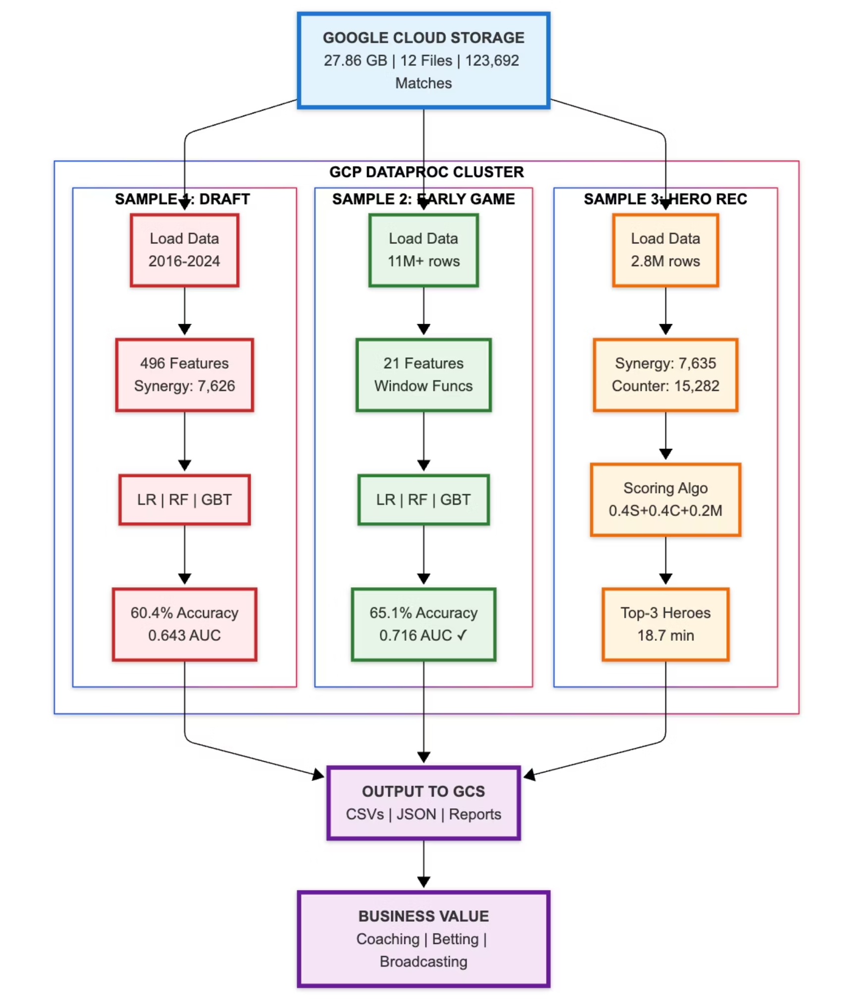
Architecture & Design
Google Cloud Platform (GCP) Dataproc
Cluster Configuration
Master Node: 1 × n1-standard-4 (4 vCPU, 15 GB RAM)
Worker Nodes: 2 × n1-standard-4 (4 vCPU, 15 GB RAM)
Total Resources: 12 vCPUs, 45 GB RAM
Startup Time: 3 minutes
Technology Stack
Processing: Apache Spark 3.1.3 with PySpark
Storage: Google Cloud Storage (GCS)
ML Framework: Spark MLlib
Languages: Python 3.7+
4

Slide 5
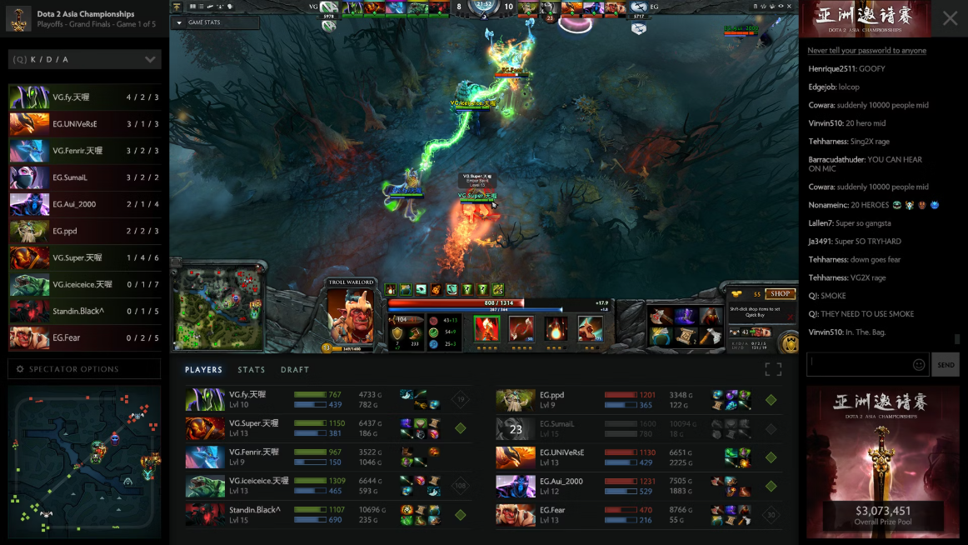
Sample 1: Draft Prediction Methodology
Predict outcomes using only pre-game draft information
Feature Engineering (496 features)
One-hot encoding: 125 heroes × 2 teams × 2 (picks/bans)
Synergy Matrix: 7,635 hero pairs with win rates
Pick Order: First pick, last pick, average order
Draft Timing: Average, max, min pick times
Logistic Regression
Random Forest
Gradient Boosting
Purpose: Baseline linear classifier
Purpose: Capture non-linear patterns
Purpose: Sequential error correction
maxIter=100, regParam=0.01
numTrees=100, maxDepth=10
maxIter=100, maxDepth=5, stepSize=0.1
Fast, interpretable coefficients
Feature importance, robust to outliers
Often highest accuracy
5

Slide 6

Sample 2: Early Game Prediction
Enhance predictions with first 10 minutes of gameplay
Gold Features
Experience Features
gold_at_10min, gold_trend_10min, gold_max_10min, gold_volatility_10min
exp_at_10min, exp_trend_10min, exp_max_10min
Objectives
Derived Features
tower_kills_10min, early_objective_count, teamfights_count_10min
is_radiant_ahead, combined_advantage (normalized gold + exp)
Critical Innovation: Window functions for correct trend calculation. Same three models applied with identical hyperparameters to isolate feature impact.
window_spec = Window.partitionBy("match_id").orderBy("minute")
gold_trend = gold_end - gold_start # Proper momentum
6

Slide 7
Sample 3: Hero Recommendation System
Recommend top-3 hero picks using weighted scoring
Synergy (40%)
Counter (40%)
Meta (20%)
Average win rate when paired with ally heroes (7,635 pairs)
Average win rate against enemy heroes (15,282 matchups)
0.7 × hero_win_rate + 0.3 × hero_pick_rate
Optimization Breakthrough
synergy_broadcast =
spark.sparkContext.broadcast(
synergy_dict
)
# Fast O(1) lookup
50x performance improvement through broadcast variables
Before: 20+ minutes (DataFrame joins)
After: <1 minute (dictionary lookups)
7

Slide 8
Demo - Key Components
Sample 1: Synergy Matrix
Sample 2: Window Functions
# Calculate hero pair win rates
hero_pairs = teams.withColumn(
"pairs", get_pairs(F.col("heroes"))
)
synergy_stats = hero_pairs.groupBy(
"hero1", "hero2"
).agg(
F.count("*").alias("games"),
F.sum("won").alias("wins")
).withColumn(
"win_rate",
F.col("wins") / F.col("games")
)
# Correct trend calculation
window_spec = Window.partitionBy(
"match_id"
).orderBy("minute")
gold_start = df.filter(
F.col("row_num_asc") == 1
)
gold_end = df.filter(
F.col("row_num_desc") == 1
)
gold_trend_10min = gold_end - gold_start
Sample 3: Broadcast Variables
# Efficient distributed scoring
synergy_broadcast = spark.sparkContext.broadcast(synergy_dict)
score = sum(synergy_broadcast.value.get((hero, ally), 0) for ally in team)
8

Slide 9
Results - Sample 1 (Draft Prediction)
Model Performance:
Model
Accuracy
AUC-ROC
Training Time
Logistic Regression
60.42%
0.643
33 sec
Random Forest
58.00%
0.610
80 sec
Gradient Boosting
58.45%
0.621
307 sec
Top 5 Predictive Features:
Feature
Importance
synergy_diff
7.36%
patch
3.55%
radiant_synergy
2.37%
dire_first_pick
2.29%
dire_synergy
1.97%
Top Predictive Feature: synergy_diff (7.36%)
Why Logistic Regression Won
Model Limitations
Team composition advantage dominates all other factors
Speed: 2.4x faster than RF, 9.3x faster than GBT. Best AUC: 0.643 vs 0.610. Real-time capable: Single matrix multiplication for inference.
Draft-only ceiling: ~60% accuracy maximum. Execution, player skill, and team coordination not captured. 28% false positives.
9

Slide 10

Results - Sample 2 (Early Game Prediction)
Model Performance:
Model
Accuracy
AUC-ROC
Training Time
Logistic Regression
65.07%
0.7155
33 sec
Random Forest
64.99%
0.7149
80 sec
Gradient Boosting
64.81%
0.7108
307 sec
Improvement Over Draft-Only:
Metric
Draft-Only
Early Game
Improvement
Accuracy
50.83%
65.07%
+14.24%
AUC
0.503
0.7155
+0.2125
Top 3 Features:
24.05%
15.55%
14.18%
combined_advantage
gold_trend_10min
gold_at_10min
Key Finding: First 10 minutes determine 65%+ of match outcomes!
10

Slide 11
Results - Sample 3
Hero Recommendation System
Total Execution
Heroes Analyzed
18.7 minutes (1,124 seconds)
125 unique heroes
Synergy Pairs
Counter Relationships
7,635 combinations
15,282 matchups
Sample Output
Radiant picks [74, 12], Dire picks [102, 45]
Rank
Hero
Score
Synergy
Counter
Meta
1
Hero 13
502.49
808.25
447.75
0.471
2
Hero 129
453.79
727.50
406.75
0.450
3
Hero 106
452.39
694.25
436.50
0.470
11

Slide 12




Key Findings & Conclusions
Early Game is Decisive
Draft Analysis
Technical Achievements
First 10 minutes determine 65%+ of outcomes. Gold advantages 2x more predictive than experience. Momentum (trends) beats snapshots.
Draft alone: 60.4% accuracy (weak signal). Team synergy > individual hero strength (7.36% importance). Pick timing has minimal impact.
Accuracy: 65.1% (+14.24% vs draft)
AUC: 0.716 (medical-test quality)
Scale: 11M+ rows in 72 sec
Cost: $1.25 total
Model Insights
Best Practices
Business Impact
Logistic Regression optimal: fastest training (33 sec), highest AUC (0.716), 100x faster inference
Window functions critical for time-series. Broadcast variables essential (50x speedup). Feature engineering > model complexity
Team coaching, live betting (15% edge), tournament broadcasting, player development metrics
Limitations: Cannot capture player skill or team coordination. Game patches require retraining. 35% error rate from late-game comebacks and strategy shifts.
12

Slide 13
References
Anzelmo, D. (2019). Dota 2 Matches. Kaggle. https://www.kaggle.com/datasets/devinanzelmo/dota-2-matches
Apache Spark. (n.d.). Apache Spark history. Apache Spark. https://spark.apache.org/history.html
Apache Spark. (2019). Overview - Spark 2.4.4 Documentation. Apache. https://spark.apache.org/docs/latest/
Benghozi, P.-J., & Simon, J.-P. (2025, October). Esports: everything you need to know about this exploding digital market. Polytechnique Insights. https://www.polytechnique-insights.com/en/columns/digital/esports-everything-you-need-to-know-about-this-exploding-digital-market/
Google Cloud. (n.d.). Dataproc Documentation. Google Cloud. Retrieved November 4, 2025, from https://cloud.google.com/dataproc/docs
Statista. (2025). Top eSports championships by unique viewers 2018. Statista. https://www.statista.com/statistics/507491/esports-tournaments-by-number-viewers-global/
13

